Slide 1

FOG/HAZE REMOVAL (from single image and real-time video)
Submitted by :- Soumam Banerjee
( NIT Durgapur, Biotech dept)
Notes:
‹#›

Slide 2
The Problem
Fog, Haze, or Smog
Want a clear image
Flight , ship and train delays
Accidents due to improper vision
Missile tracking in EOTS (Electro Optical Tracking System) gets difficult due to foggy occlusion
Notes:
‹#›

Slide 3
Haze Removal Techniques
Multiple image haze removal technique :-
weather condition based technique
polarization based technique
depth map based technique
Single image haze removal technique :-
contrast maximization
independent component analysis
dark channel prior technique (method I used)
anisotrophic diffusion technique

Slide 4
The Method
Outlined in paper:
Single Haze Removal Using Dark Channel Prior
by Kaimin He, Jian Sun, and Xiaoou Tang
Notes:
‹#›

Slide 5
What is haze?
I(x) = J(x)t(x) + A(1 − t(x))
Direct Attenuation
Airlight
I(x): Observed hazy image
J(x): Scene Radiance or Haze-free image
A: Atmospheric Light
t(x): Transmittance
Notes:
‹#›

Slide 6
Steps followed to achieve the desired output :-
Dark Channel Construction
Atmospheric light estimation
Transmission Map Estimation
Transmission Map Refinement
Restoring the haze free image

Slide 7
Dark Channel Prior
Objects of interest have low values in at least one color channel
Green leaf
Car Shadow
Dark building
Haze has a high pixel intensity
Notes:
‹#›

Slide 8
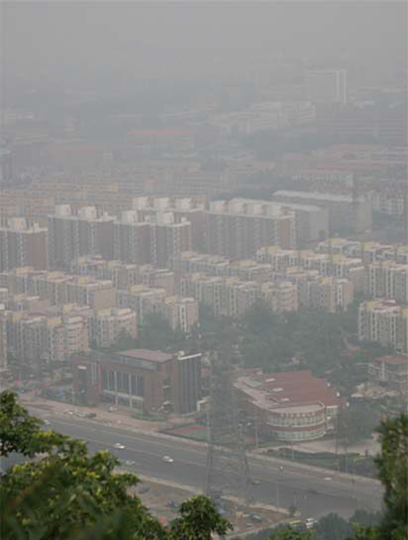
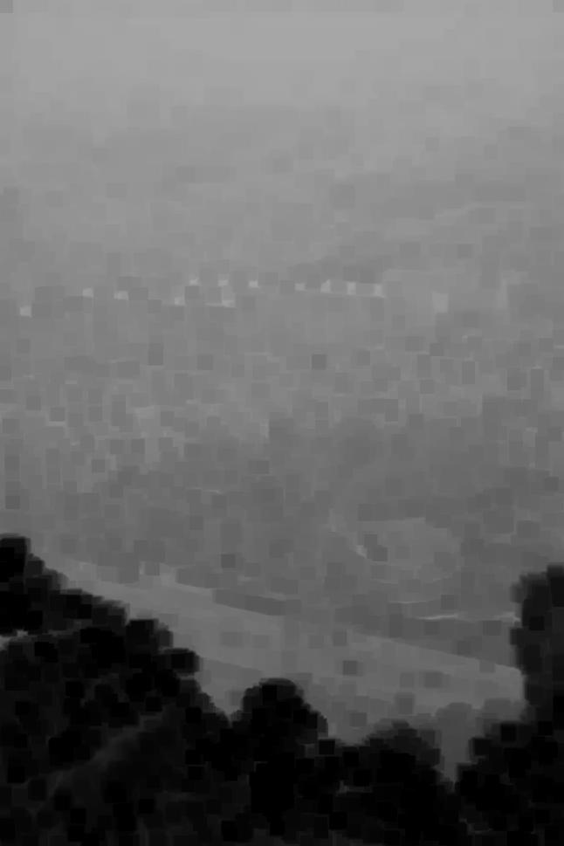

INPUT IMAGE
DARK CHANNEL
Notes:
‹#›

Slide 9
Compute Atmospheric Light
I(x) = J(x)t(x) + A(1 − t(x))
High values in Dark Channel
Take top 0.1%
Pull Values from original image
Average
Notes:
‹#›

Slide 10
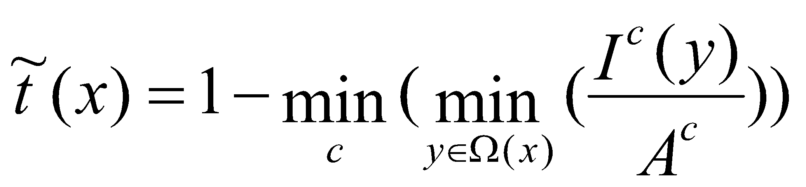
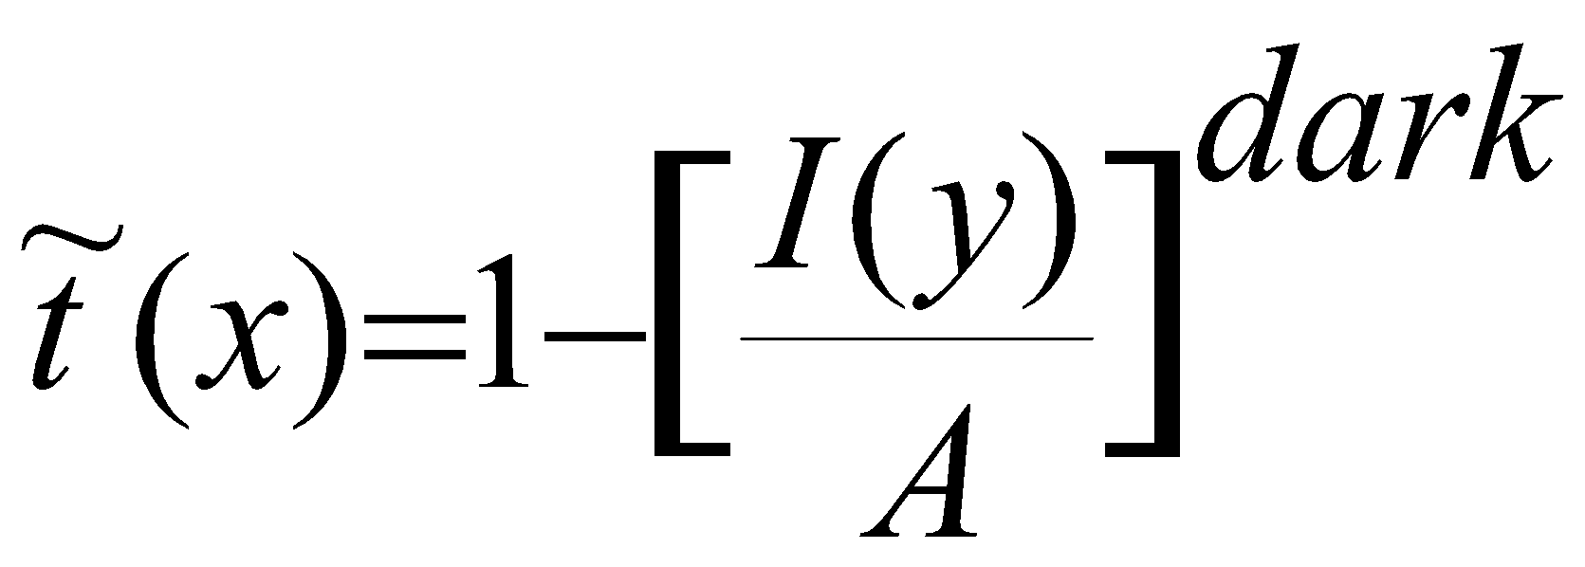
Estimating Transmission
Shuffling the Haze Equation and taking min’s gives you:
Which is simply:
Notes:
‹#›

Slide 11
Show the desired Calculations :-
I(x) = J(x)t(x) + A(1 − t(x))

Slide 12
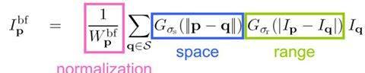
Bilateral Filter
The bilateral filter is defined as:
A bilateral filter is a non-linear, edge-preserving, and noise-reducing smoothing filter for images. It replaces the intensity of each pixel with a weighted average of intensity values from nearby pixels.
Notes:
‹#›

Slide 13
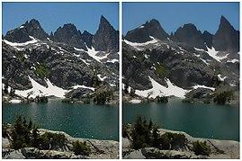
Refine Transmission with bilateral filter
Estimated Transmission is blocky
Want to take into account fine detail
Notes:
‹#›

Slide 14
Things to improve
Performance
Processing Time
(at present its 0.4 secs for hd image of height---> 1235 and width----> 2572
0.08 secs for an image with dimensions 600x400 )
Memory Allocation
A GUI based implementation of the software in PyQt/Tkinter
Notes:
‹#›

Slide 15
Things To Expand
Depth Map
From Transmittance
3D Model
Image Enhancement
Histogram Equalization (on the basis of past data, but it won’t be then real-time)
Notes:
‹#›

Slide 16
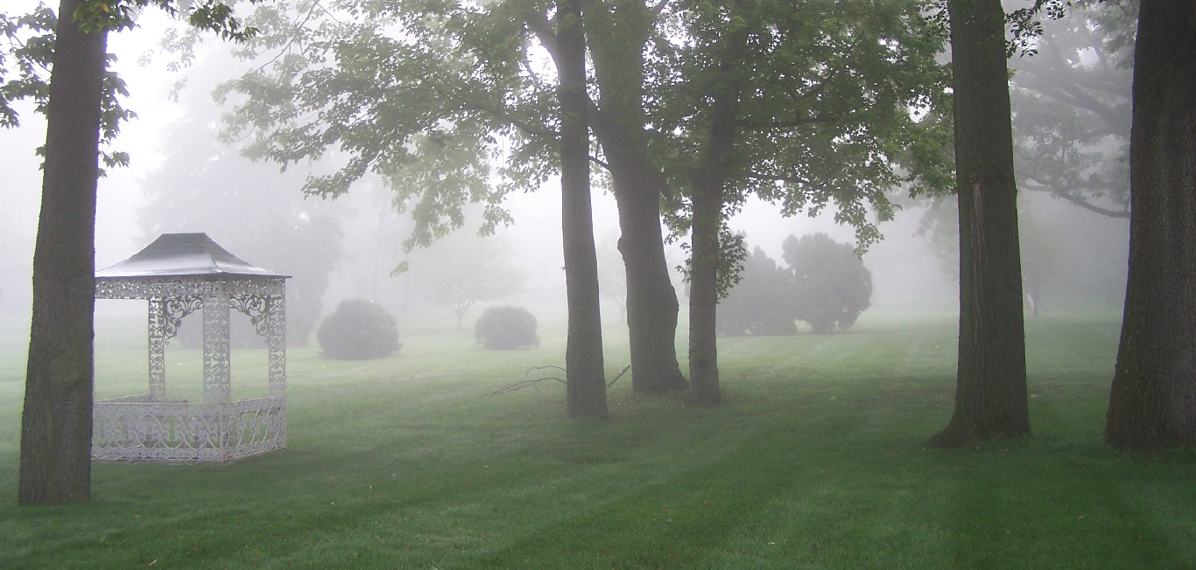
Current Results
Input foggy/hazy image
Notes:
‹#›

Slide 17
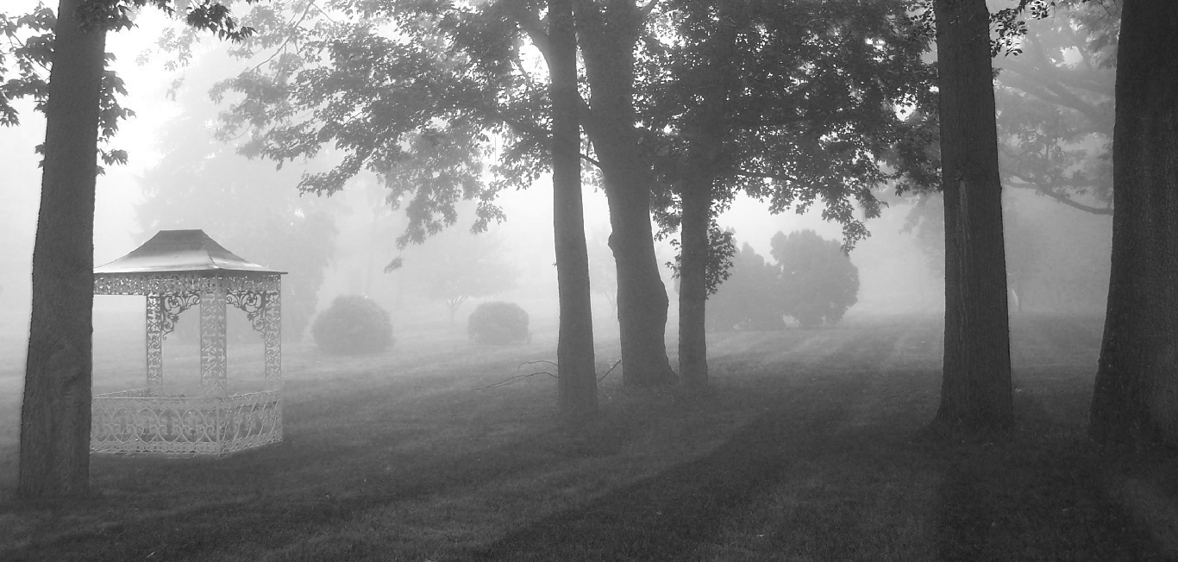
Dark Channel
Dark Channel ( without using 𝞨 channel [using it would make it more accurate but computationally a bit expensive])
Notes:
‹#›

Slide 18
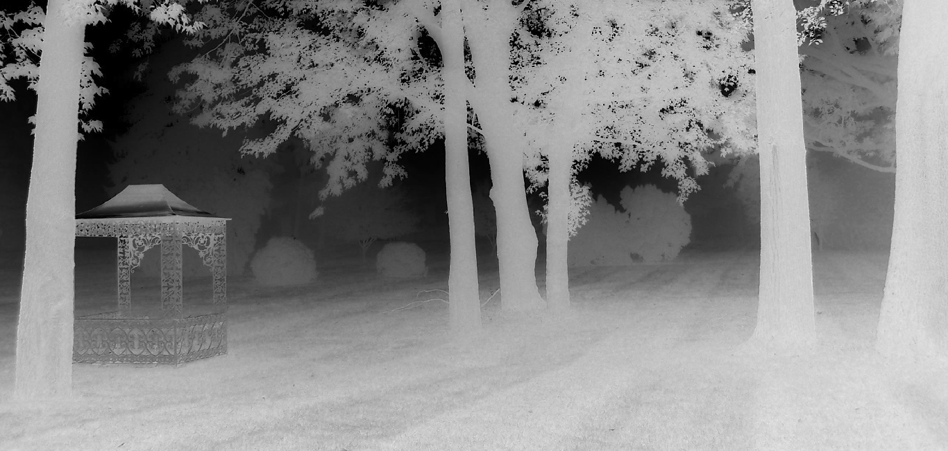
Transmission Map
Notes:
‹#›

Slide 19
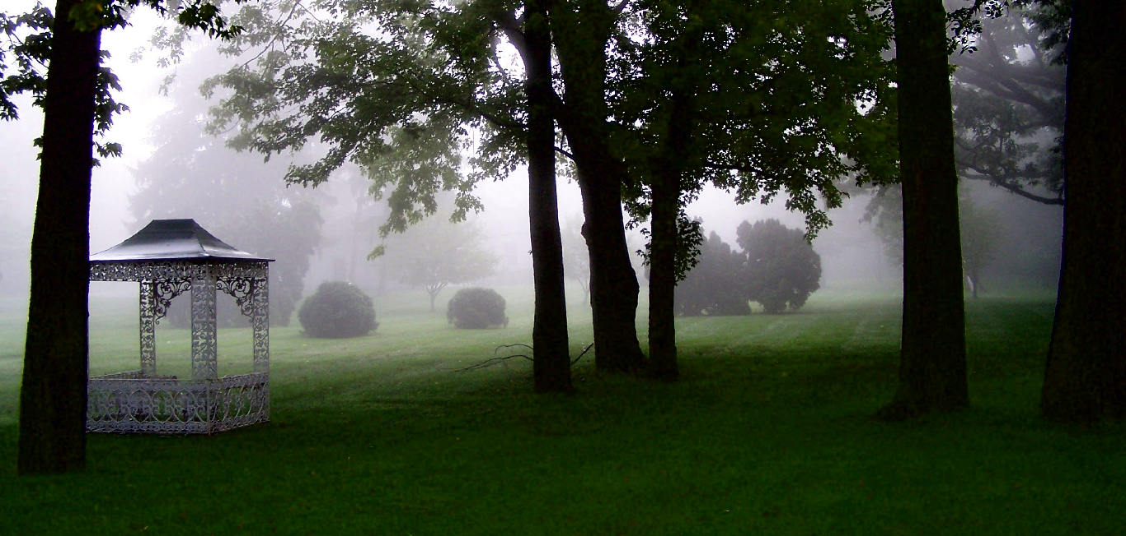
INPUT IMAGE
OUTPUT IMAGE
Notes:
‹#›

Slide 20
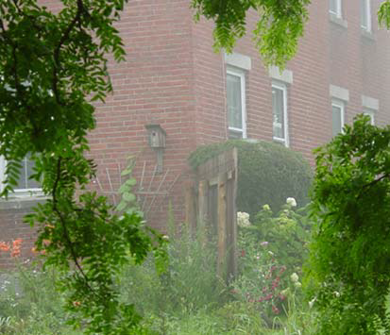
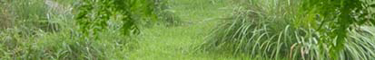
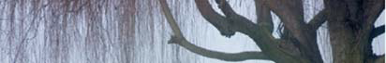
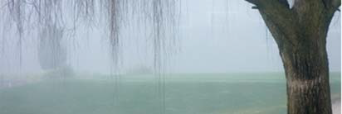
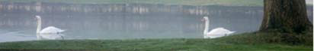
Few more inputs and their outputs
Notes:
‹#›

Slide 21
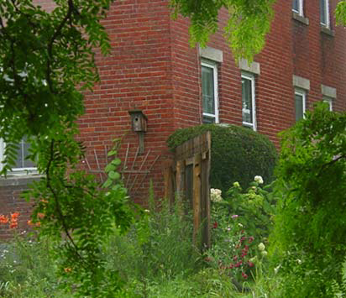
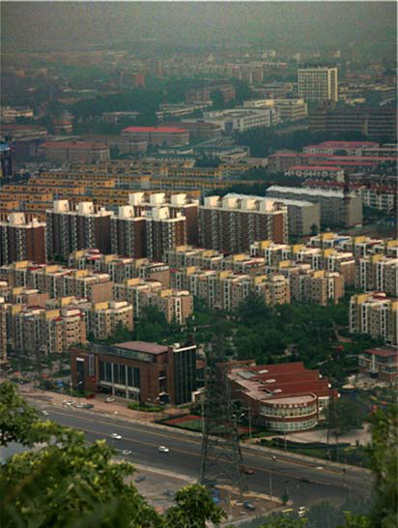

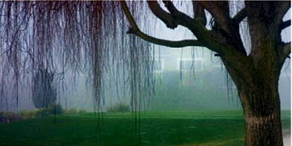
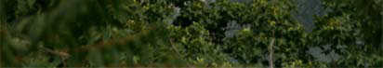
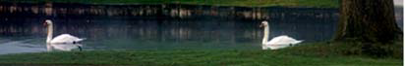
Notes:
‹#›

Slide 22
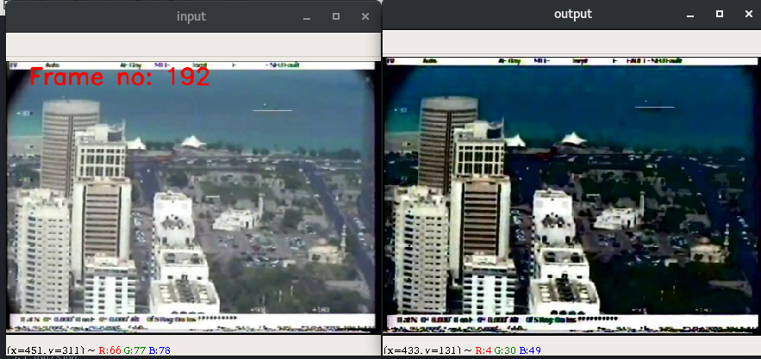
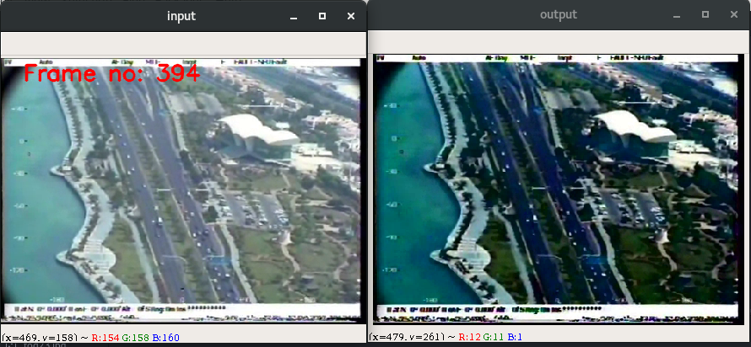
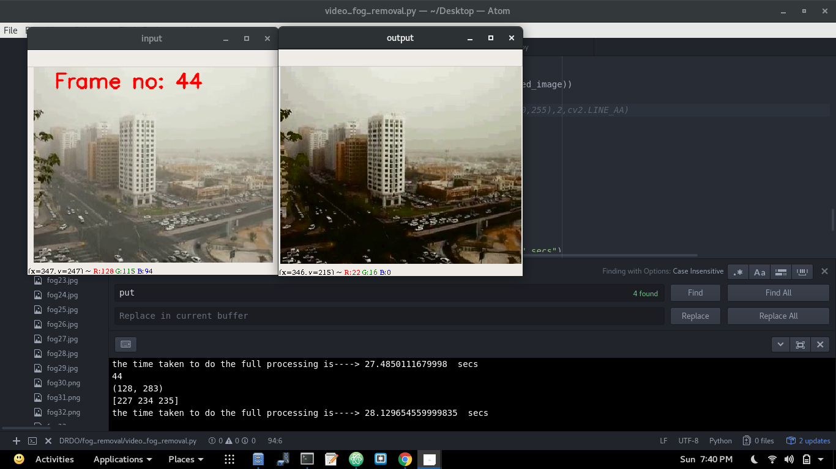
Video Results
Input and output of ‘fog_video_1.mp4’ (Frame no:- 192)
Input and output of ‘fog_video_1.mp4’ (Frame no:- 394)
Input and output of ‘fog_video_2.mp4’ (Frame no:- 44)
Notes:
‹#›

Slide 23
References
Digital Image Processing - R.Gonsalves
openCV 3.4.1 Documentation
https:// www. stackoverflow.com
Python 3.6 documentation
Lee et al. EURASIP Journal on Image and Video Processing (2016) 2016:4 DOI 10.1186/s13640-016-0104-y
A.k. Tripati and S.Mukhapadhay, “single image fog removal using bilateral filter ,” 2012 IEEE internal Conference On signal Processing ,Computing and Control , Waknghat Solan ,2012,pp.1-6.
K He , J Sun ,XTang , Proceedings of IEEE Computer Society Conference on Computer Visionand Pattern Recognition(CVPR, Miami,2009),pp.1956-1963
H Xu , J Guao ,L ye ,fast image dehazing using improved DCP in Proceedings of International Conference on Information Science and Technology(ICIST, Hubei,2012), pp.663-667
K He , J sun, X Tang , Proceedings of IEEE Computer Society Conference on Computer Vision and pattern Recognition(CVPR, Miami,2009), pp. 1956-1963

Slide 24
“ Just like to hear is not just same as to listen similarly to take pictures is not to see and by seeing I mean understanding !
Even the smartest machines are blind till date, we gotta make ‘em smarter ! “
--- Fei Fei Li, Director of Stanford AI Lab,
Founder of Image Net
Thank You!
Notes:
‹#›

